Slide 1
EECS E6895 - Milestone 3 A-share Stock Auto Trader
B9: Investment Strategy - AI Trader (CN/HK/TW/JP)
Yiwen Fang (yf2560) | Guoshiwen Han (gh2567)

Slide 2
Frontend / UI
Model training refinement
Experiments & Evaluation
Timeline
Q & A

Slide 3

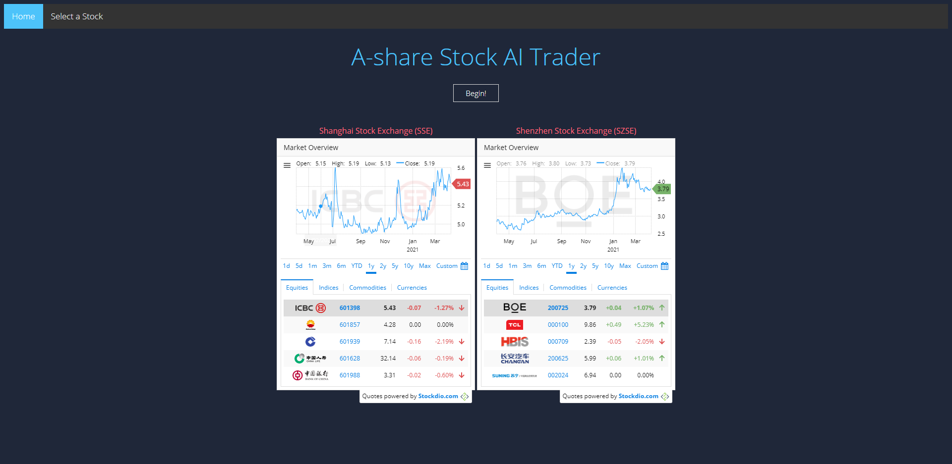
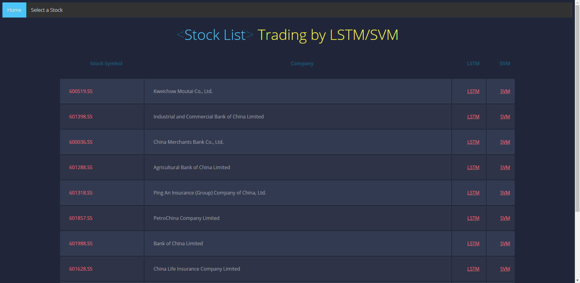
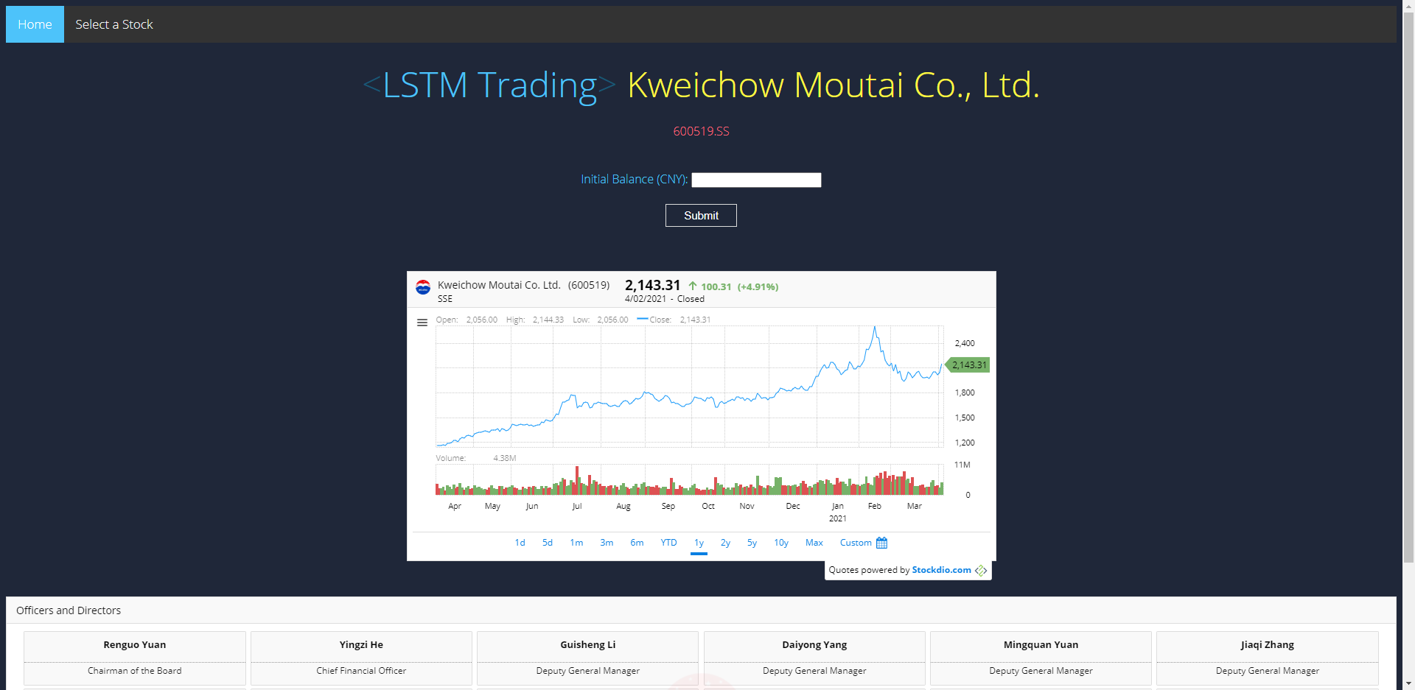
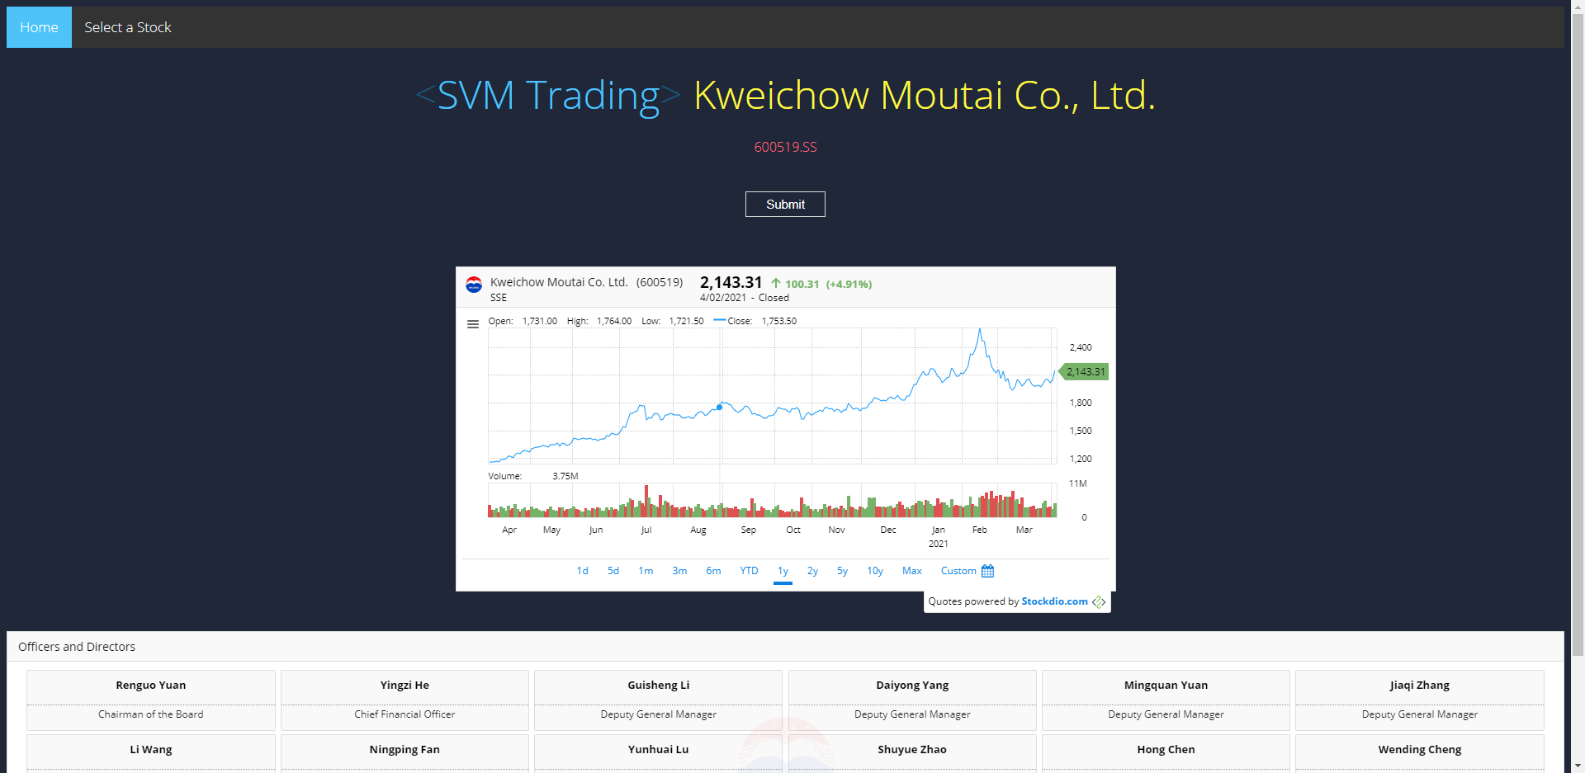
Frontend / UI
Home page
Stock list with LSTM/SVM
Start LSTM trading with real-time data
Start SVM trading with real-time data

Slide 4
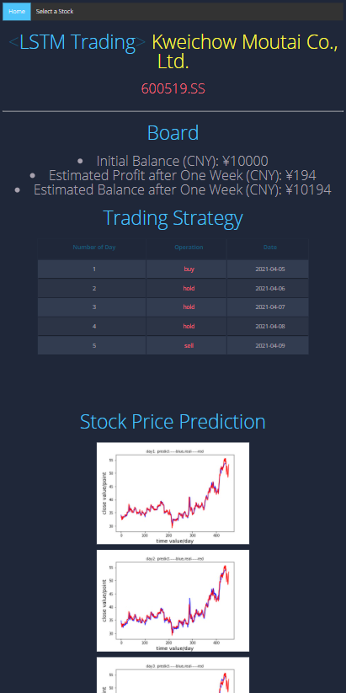
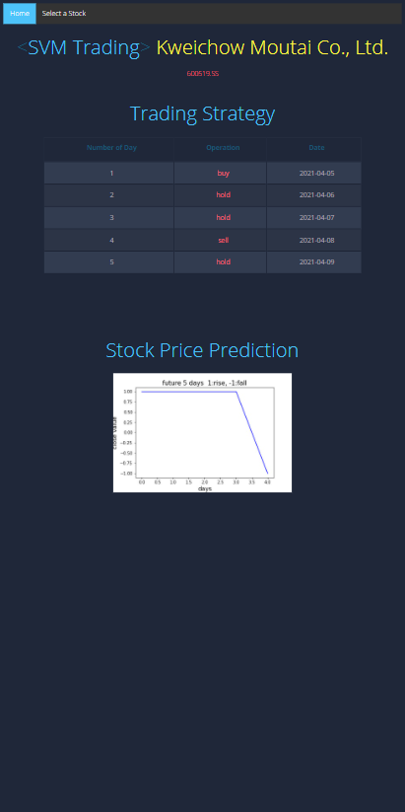
Frontend / UI
Suggested LSTM trading strategy
Suggested SVM trading strategy

Slide 5
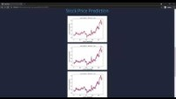
Frontend / UI Video
Source: https://youtu.be/mKN3sfGr4Yw

Slide 6
Model Training Refinement
1. About data process
value = pd.Series(Data['close'].shift(-n)-Data['close'],index=Data.index) #after n days, rise or fall Data['High-Low'] = Data['high']-Data['low'] #Difference between High and Low Data['Open-NClose']=Data['open']-Data['close'].shift(n) #today's open - close of n days before Data['Close-NClose']=Data['close']-Data['close'].shift(n) #Today is rise or fall comparing with n days before Data['Close-Open']=Data['close']-Data['open'] #today's Close - Open Data['High-Close'] = Data['high']-Data['close'] #today's High - Close Data['Close-Low'] = Data['close']-Data['low'] #today's Close - Low value[value>0]=1 #1 means rise value[value==0]=0 #0 means it doesn't rise or fall value[value<0]=-1 #-1 means fall Data=Data.dropna(how='any') del(Data['open']) del(Data['close']) del(Data['high']) del(Data['low']) print(Data) #print(type(Data)) Data['Value']=value
This time we change all the data, now the model is not based on the absolute values of prices, but on the relation between the prices.
Correspondingly, our prediction result only has 3 values: 1 means the stock will rise; -1 means the stock will fall; 0 means the price dosen’t change.

Slide 7
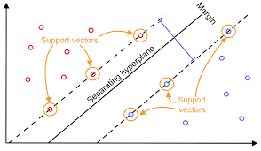
Model Training Refinement
2. About model training
This time we change training method from lstm to SVM.
classifier = svm.SVC(kernel='poly',degree=20) #kernel='poly',(gamma*u'*v + coef0)^degree classifier.fit(Data_train,value_train) value_predict=classifier.predict(Data_predict) print("value_real: ", value_real) print("value_predict: ", value_predict) if(int(value_real)==int(value_predict)): correct=correct+1
classifier = svm.SVC(kernel='poly',degree=20)
Here we choose kernel equals poly and degree equals 20 according to experiment results.
https://static.packt-cdn.com/products/9781789345070/graphics/6a831600-9a0d-429f-9d34-d957c45b9517.png

Slide 8
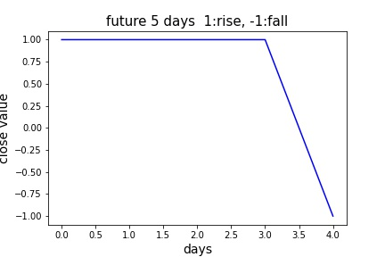
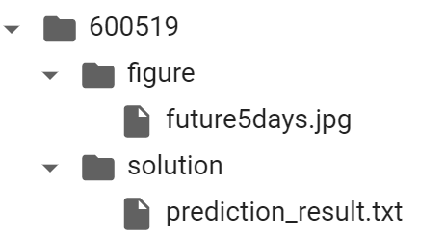
Model Training Refinement
2. About model training
Take 600519 as an example, the training result is:
There will be 3 prediction results: 1, 0, and -1.
1 means this stock will rise.
0 means this stock will fall.
-1 means this stock won’t change.
And we will give out our operations according to the prediction:
day1 | day2 | day3 | day4 | day5
buy | hold | hold | sell | hold

Slide 9
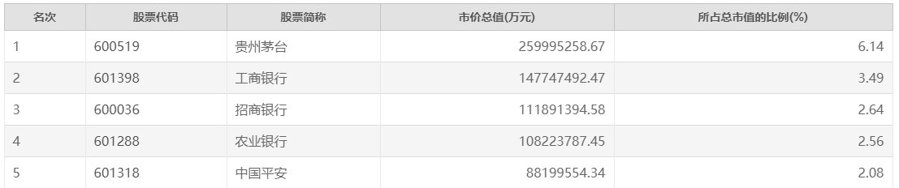
Experiments & Evaluations
We still selecte top 5 stocks by market capitalization to test our model.
Ranking
Stock code
Stock abbreviation
Total market value (ten thousand yuan)
Total market share (%)
Last time, we give out trading operations that should be executed according to LSTM model:
600519:
601288:
day1 | day2 | day3 | day4 | day5
2105.601 | 2145.876 | 2245.104 | 2162.372 | 2237.245
buy | hold | sell | buy | sell
day1 | day2 | day3 | day4 | day5
3.075491 | 3.022646 | 3.562933 | 3.529859 | 3.536449
hold | buy | sell | buy | sell
601398:
601318:
day1 | day2 | day3 | day4 | day5
5.378158 | 5.417605 | 5.439079 | 5.530206 | 5.373069
buy | hold | hold | sell | hold
day1 | day2 | day3 | day4 | day5
86.36325 | 83.28569 | 85.2497 | 87.23275 | 86.70916
hold | buy | hold | sell | hold
600036:
day1 | day2 | day3 | day4 | day5
53.55167 | 54.04567 | 54.48933 | 55.10054 | 55.49297
buy | hold | hold | hold | sell

Slide 10
Experiments & Evaluations
This time, we give out trading operations that should be executed according to SVM model:
600519:
601288:
day1 | day2 | day3 | day4 | day5
buy | hold | hold | sell | hold
day1 | day2 | day3 | day4 | day5
hold | buy | hold | sell | hold
601398:
601318:
day1 | day2 | day3 | day4 | day5
hold | hold | hold | hold | hold
day1 | day2 | day3 | day4 | day5
buy | hold | sell | hold | hold
600036:
day1 | day2 | day3 | day4 | day5
buy | hold | hold | hold | sell

Slide 11
Experiments & Evaluations
Take the real prices of Kweichow Moutai and ICBC to evaluate the performance of our SVM model:
buy
hold
sell
buy
sell
buy
hold
hold
sell
hold
LSTM:
SVM:
day1 | day2 | day3 | day4 | day5
2105.601 | 2145.876 | 2245.104 | 2162.372 | 2237.245
buy | hold | sell | buy | sell
day1 | day2 | day3 | day4 | day5
buy | hold | hold | sell | hold
correct rate: 2/5
correct rate: 5/5

Slide 12
Experiments & Evaluations
Take the real prices of Kweichow Moutai and ICBC to evaluate the performance of our SVM model:
buy
hold
hold
sell
hold
hold
hold
hold
hold
hold
LSTM:
SVM:
day1 | day2 | day3 | day4 | day5
5.378158 | 5.417605 | 5.439079 | 5.530206 | 5.373069
buy | hold | hold | sell | hold
day1 | day2 | day3 | day4 | day5
hold | hold | hold | hold | hold
correct rate: 1/5
correct rate: 3/5

Slide 13
Timeline
Milestones 3
Final Project
Model training evaluation and tuning
Frontend coding
Make Django web app assembled of both frontend and backend
Extend the training methods to get more models, and then make operation decisions based on the prediction results of all these models together
Update data and model automatically per week
Deployment to the cloud, like AWS

Slide 14
Q&A

